Slide 1
PROJECT TRACKING SYSTEM

Slide 2
TABLE NAME : ADMIN
FIELD NAME | FIELD TYPE | SIZE | CONSTRAINT
Id | Int | 10 | PRIMARY KEY
Username | Varchar | 15 | Not null
Password | Varchar | 20 | Not null

Slide 3
TABLE NAME : STUDENT
FIELD NAME | FIELD TYPE | SIZE | CONSTRAINT
Id | Int | 10 | Primary key
Name | Varchar | 15 | Not null
Rollno | Varchar | 15 | Not null
Department | Varchar | 15 | Not null
Classname | Varchar | 15 | Not null
Username | Varchar | 15 | Not null
Password | Varchar | 15 | Not null
Guide | Varchae | 15 | Not null
Mobile | Varchar | 15 | Not null

Slide 4
TABLE NAME : PROJECT
FIELD NAME | FIELD TYPE | SIZE | CONSTRAINT
Id | Int | 10 | Primary key
Title | Varchar | 30 | Not null
Description | Varchar | 30 | Not null
Modules | Varchar | 100 | Not null
Technology | Varchar | 100 | Not null

Slide 5
TABLE NAME: ALLOCATE
FIELD NAME | FIELD TYPE | SIZE | CONSTRAINT
Id | Int | 10 | Primary key
Student_id | Int | 10 | Foreign key
project_id | Int | 10 | Foreign key
status | Varchar | 30 | Not null

Slide 6
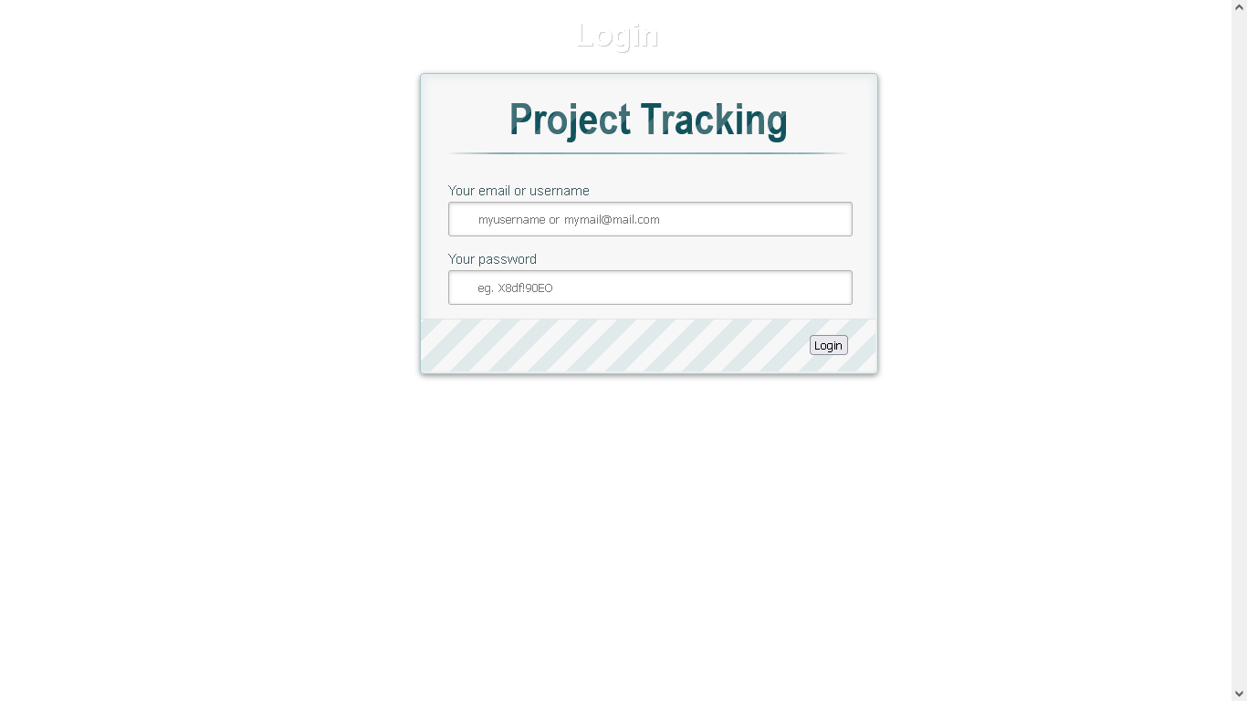

Slide 7
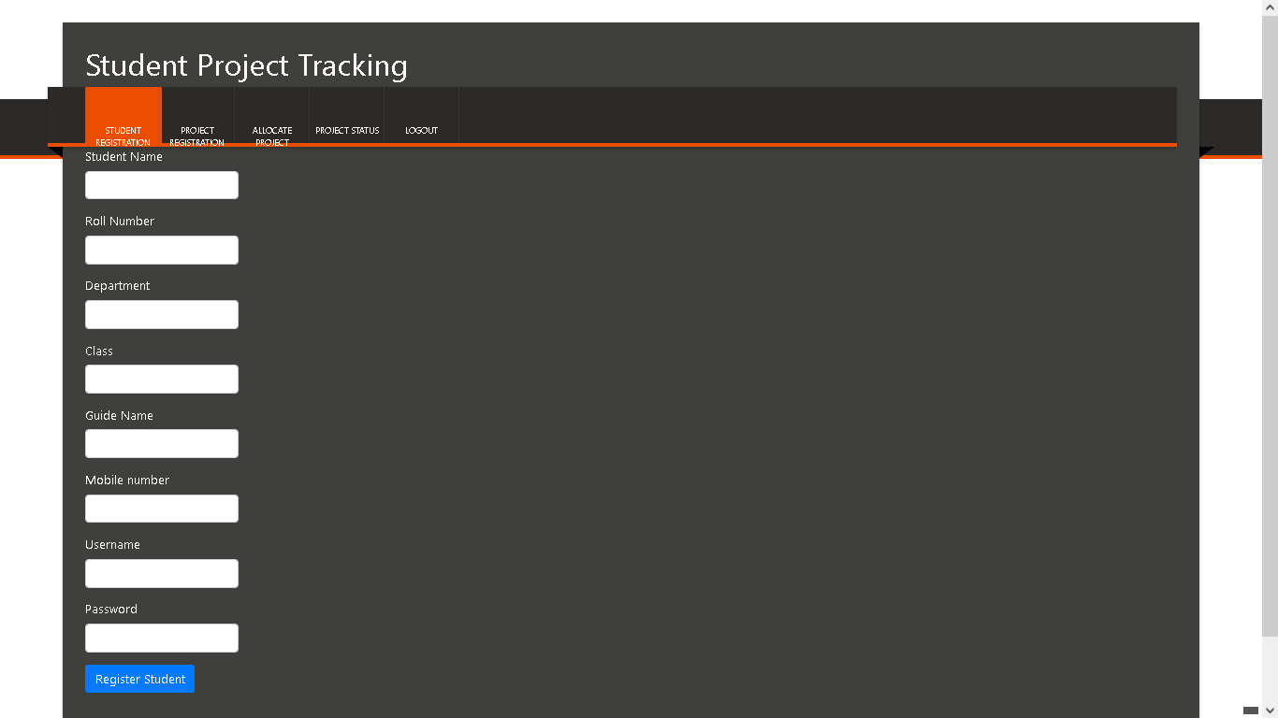

Slide 8
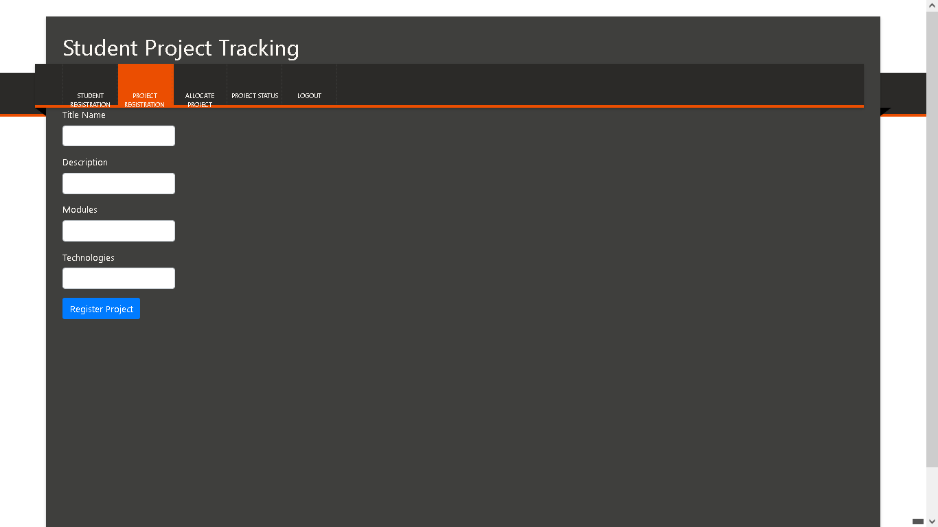

Slide 9
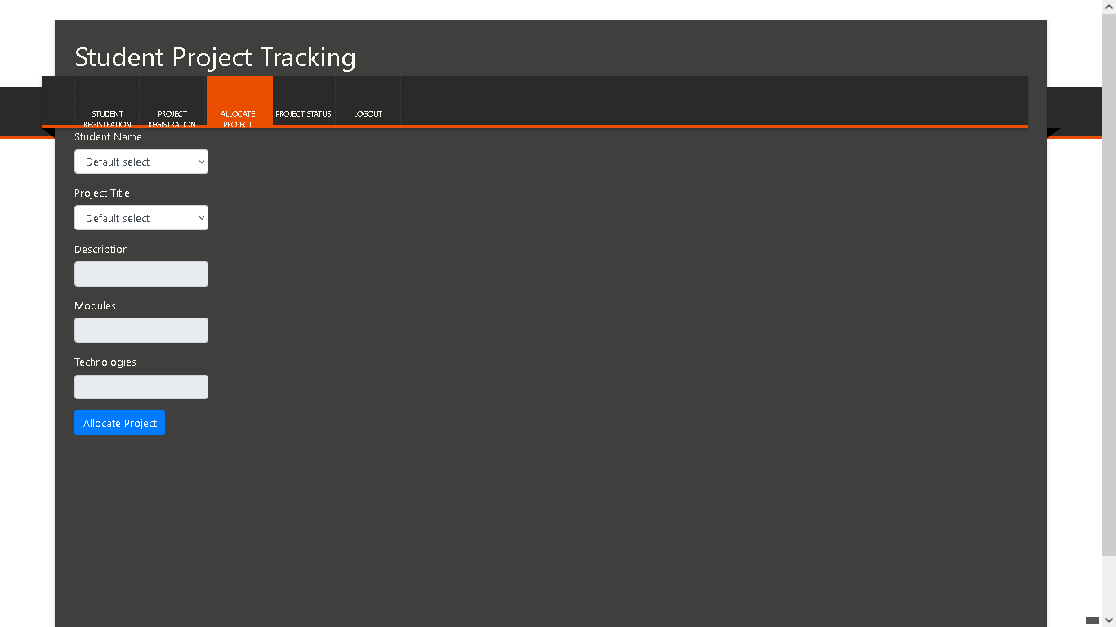

Slide 10


Slide 11
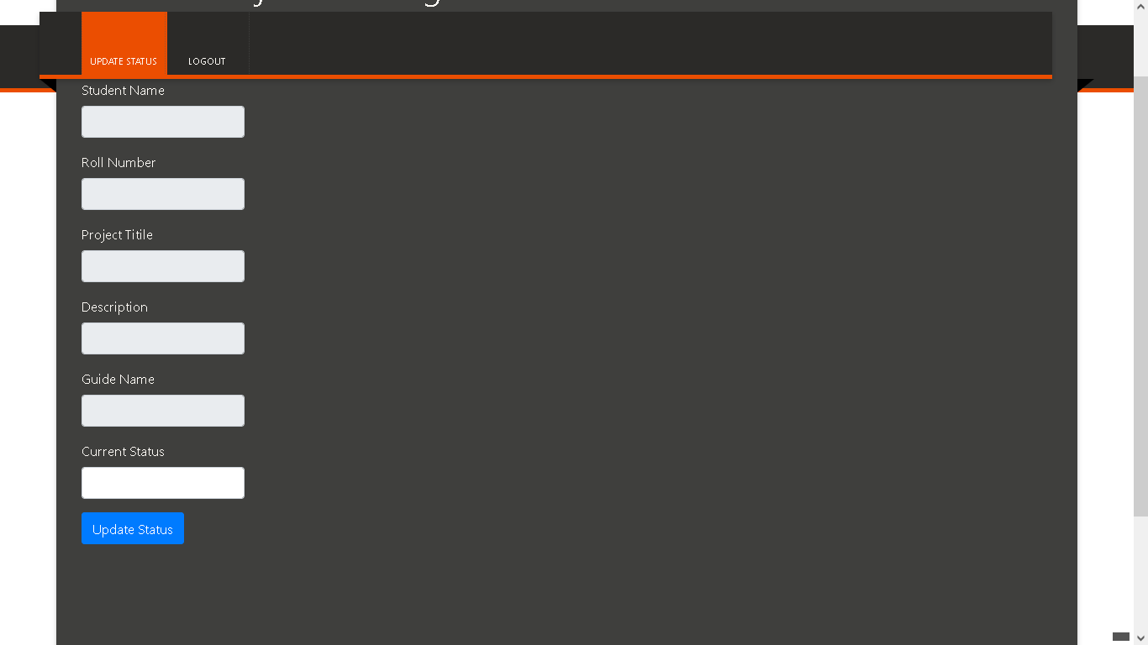

Slide 12
Thank You

